Slide 1

Machine Learning Model Training analytics
BA Data Science Job Simulation on Forage
Prepared by Nik Harith

Slide 2
ML Model training
In this task, I have used the Random Forest Classifier model to analyse the important features in the data.
The following is the evaluation of the model:
 | precision | recall | f1-score | support
0 | 0.86 | 0.98 | 0.92 | 8520
1 | 0.54 | 0.11 | 0.18 | 1480
Accuracy |  |  | 0.85 | 10000
Macro average | 0.70 | 0.55 | 0.55 | 10000
Weighted average | 0.82 | 0.85 | 0.81 | 10000

Slide 3
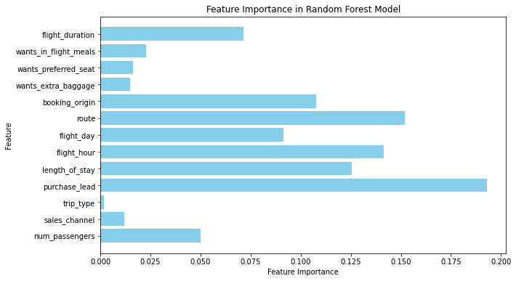
Feature Importance analysis

